Slide 1

LICA MINOR PROJECT MAKING OF DARK SENSOR USING LM358 IC AND LDR BATCH NO. : 2
Under the esteemed guidance of V. Harshitha
SUBMITTED BY:
M. Sai Kishore (171FA05305)
R. V. L. Karthik (171FA05329)
S. Tushar (171FA05362)

Slide 2
CONTENTS:
S.NO | Name | Page no.
1 | Abstract | 3
2 | Introduction | 4
3 | Pin diagram of LM358 | 5
4 | Circuit diagram | 6
5 | Components required | 7
6 | Designing | 8
7 | Working | 9 – 10
8 | Output | 11
9 | Hardware output | 12-13
10 | Advantages, disadvantages and applications | 14

Slide 3
ABSTRACT :
In this project we are going to design a dark sensor circuit using LM358 IC and LDR. The main function of this circuit is it will be in ON condition when surroundings are dark, similarly it will be in OFF condition when surroundings are dark. It is a automatic switching of LED depending on light intensity.

Slide 4
INTRODUCTION :
In general automation of things plays an important role in our daily routine. So we have to be a part of automation of things.
In this project we designed a circuit which works on the intensity of the light.
Here we designed a dark sensor using an op-amp LM358 IC and LDR. In this circuit the LED will glow automatically by sensing the surroundings light intensity.
when it becomes dark (i.e. night) the LED will glow and if the surroundings becomes brighter (i.e. day time) the LED will automatically turn OFF.
The LM358 IC is a low power dual operational amplifier which is available at low cost. It consists of 8 pins. In internal circuit of this IC there are two comparator circuits, but in this circuit design we are making use of only one comparator.
The light dependent resistor (LDR) is a kind of photo resistor and it is available in market at low cost. The resistance value of LDR is purely depends upon the intensity of the light. If the light increases then the resistance will decrease and if the light decreases then the resistance will increase.

Slide 5
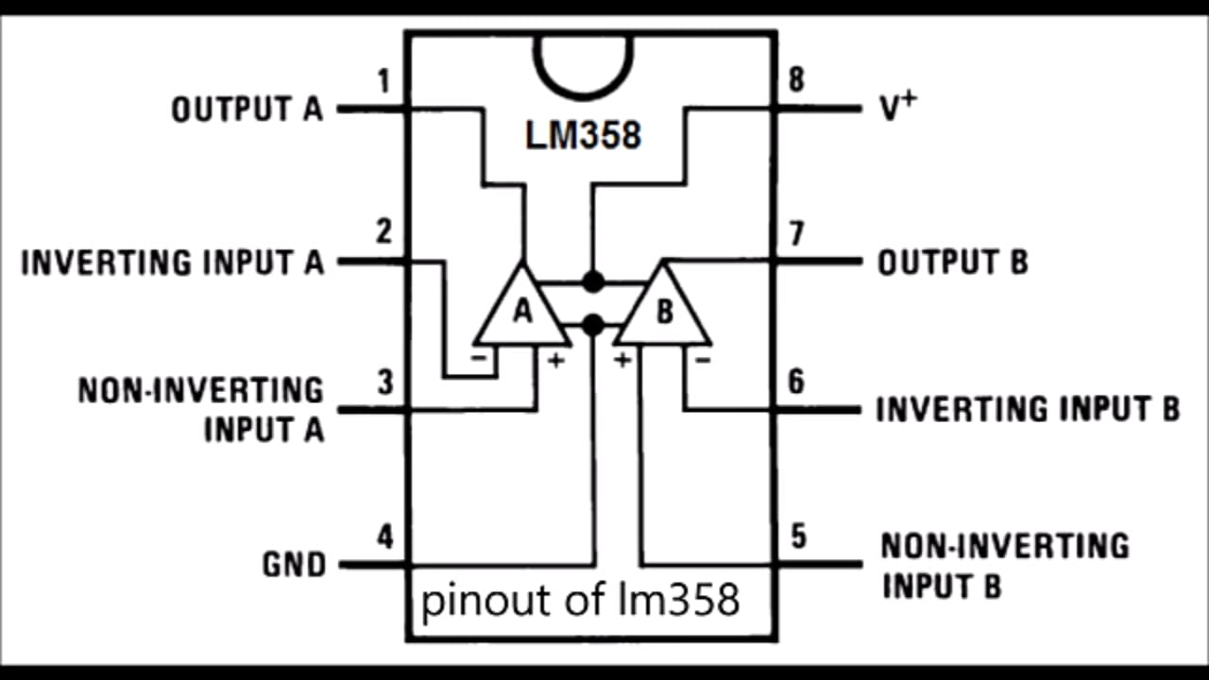
Pin diagram of LM358 IC:

Slide 6
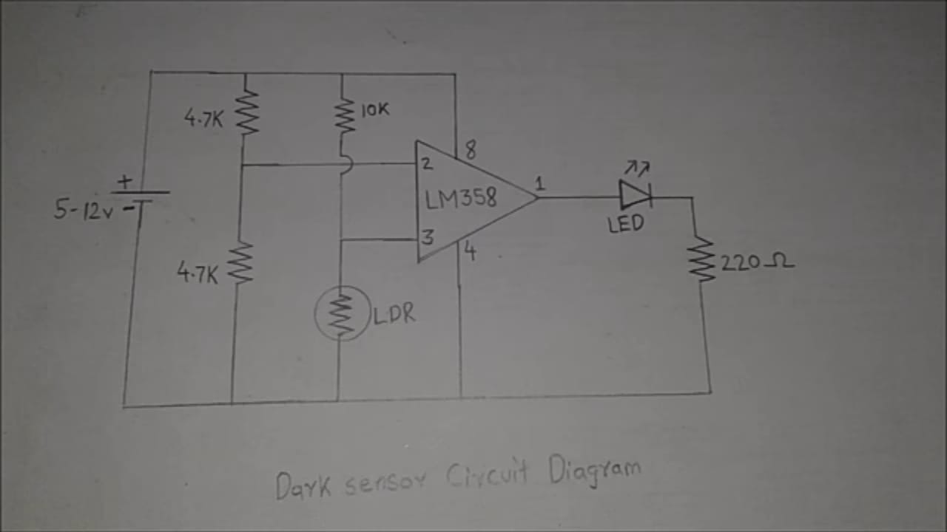
Circuit diagram:

Slide 7
Components required:
LM358 IC
LDR (light dependent resistor)
4.7KΩ resistors – 2
10KΩ resistors – 2
220Ω resistor – 1
LED (light emitting diode)

Slide 8
Designing :
Connect two 4.7K ohm resistors parallel with 9V battery. And also connect 10K ohm resistor and LDR back to back parallel with battery.
Identify the pins of LM358 IC correctly and connect 8th pin to +v and 4th pin to ground. Connect the inverting i/p terminal in between the two 4.7K ohm resistors and similarly connect non inverting i/p in between the 10K ohm resistor and LDR.
Now connect the o/p (pin no. 1) of IC to the positive terminal of LED and negative terminal to the 220 ohm resistor followed by ground.
Finally, make ensure that the connections are connect.

Slide 9
WORKING :
In this circuit the LM358 IC acts as basic comparator operated in non inverting mode. The basic working of comparator in this circuit is when the non inverting terminal is supplied with high voltage than the inverting terminal then the output will be high. If the non inverting terminal is supplied with low voltage than inverting terminal then the output will be low (i.e. zero).
Since the inverting terminal is connected in between the two 4.7K ohm resistors which are connected in parallel with the battery (9V), the inverting terminal is supplied with some reference voltage like 4.5V (we can get it by using potential divider rule) .
The non inverting input terminal is connected in between the LDR and 10K ohm resistor.
case(1) : when LDR is exposed to light.

Slide 10
As the light increases then the resistance of LDR decreases in the order of ohms (say by 100Ω ) by applying potential divider rule at node connected to non inverting i/p terminal we get 0.8V.
Here the non inverting i/p voltage is less than inverting i/p voltage so the o/p will be zero (i.e. LED will not glow).
Case(2) : When the LDR is not exposed to light.
As the light decreases then the resistance of LDR increases in the order of Mega Ohms (say by 1MΩ) by applying potential divider rule at node connected to non inverting terminal we get 8.9V.
Here the non inverting i/p voltage is greater than inverting i/p voltage so the o/p will be high (i.e. LED will glow).

Slide 11
OUTPUT:
When LDR is exposed to light then LED will not glow (OFF).
When LDR is not exposed to light then LED will glow (ON).

Slide 12
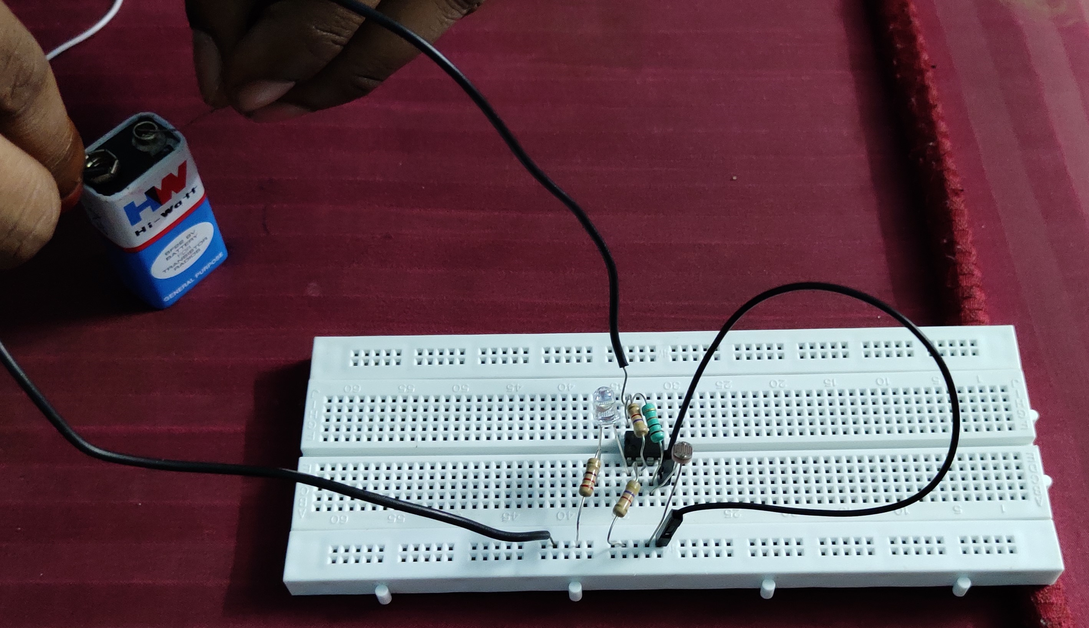
Hardware output: When LDR is exposed to light then LED will not glow (OFF).

Slide 13
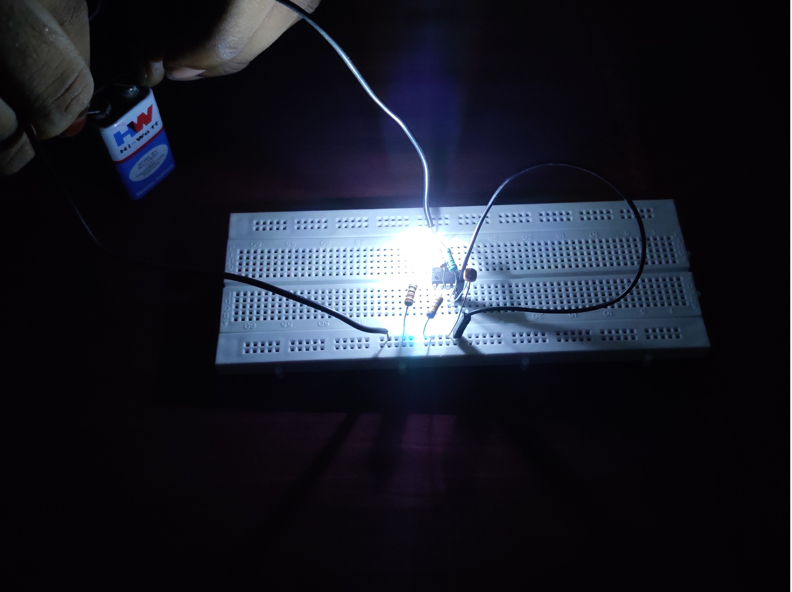
Hardware output: When LDR is not exposed to light then LED will glow (ON).

Slide 14
ADVANTAGES:
Low cost
Less complex circuitry
Simple and efficient
This circuit saves time.
Automatic control.
DISADVANTAGES:
Some times it is problem in cloud weather conditions.
Continuously we need to clear dust on LDR after few days.
APPLICATIONS:
Used in street lights.
Lamp post.
CC Cameras (night mode).

Slide 15
THANK YOU

